Slide 1
Learning Target:
Today I will be able to analyze the economies of SW Asia next week
Today’s Agenda:
Opening – Warm Up
Work Session
Economic System Notes
3. Closing
CNN10
Warm Up:
A product of the earth (“gift of nature”) that people use to meet their needs is a
good.
natural resource.
free enterprise.
service.
11 November, 2019

Slide 2
Think: If you were in charge of a nation, how would you run the economy?

Slide 3
Bell Work Why are all countries’ economies mixed? Why can’t a country be completely market or command?

Slide 4
Economic Systems of the Middle East
Learning Target: Describe the similarities & differences for the economic systems of Israel, Saudi Arabia, Turkey, & Iran

Slide 5
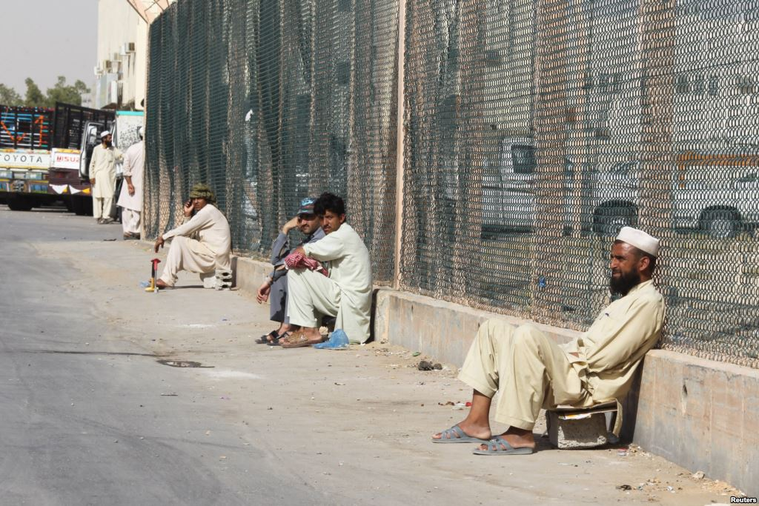
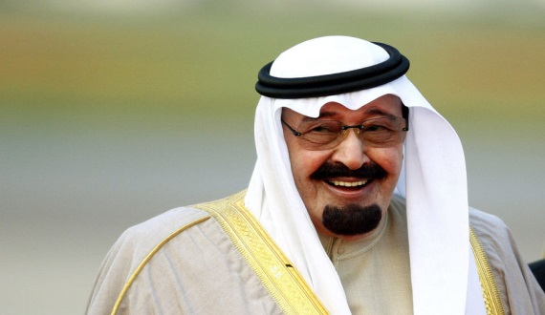
Economic System of Saudi Arabia
Mixed, but mostly command (emerging market)
The king and his advisors make most of the decisions about how and where to use oil profits
Issues: High unemployment, inefficient state-owned industries, and economic swings

Slide 6
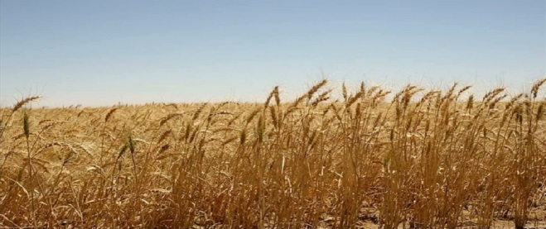
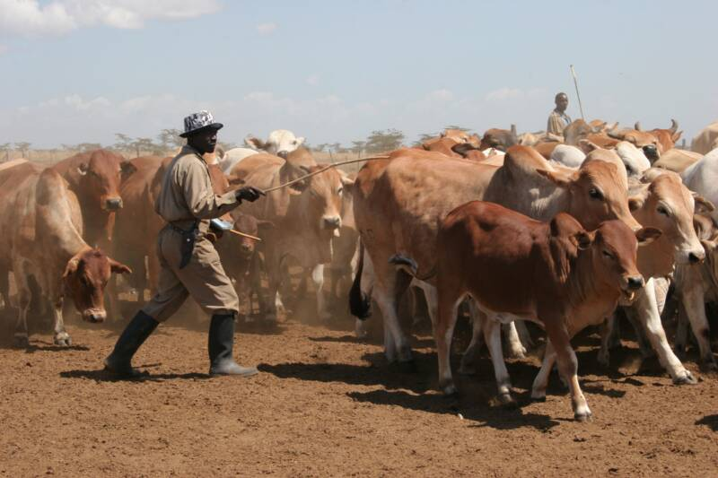
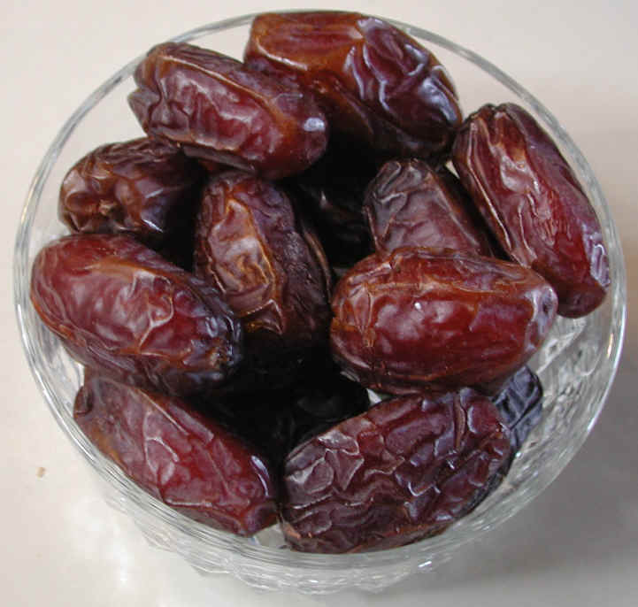
Natural Resources
Petroleum
(harsh climates means not many goods)
Saudis can buy most goods cannot provide themselves (oil rich)

Slide 7
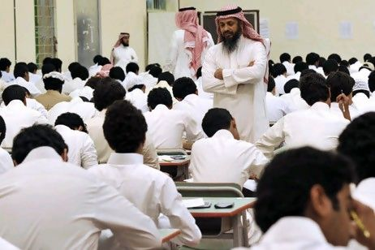
Human Capital
Profits from invested in technologies country improvement and the education system
Saudi Arabia dedicated $57.9 billion to education and training

Slide 8
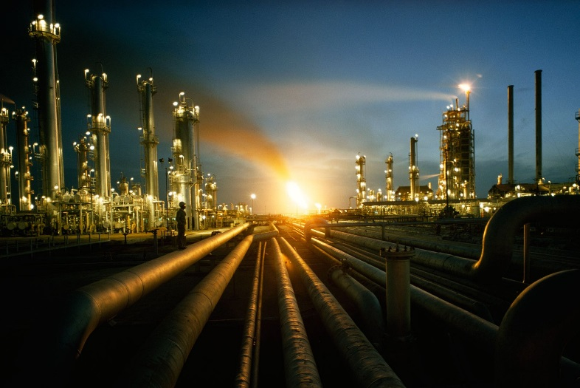
Capital Goods
Profits from oil invested in technologies for the Petroleum industry
Imports machinery, mechanical appliances, and electrical equipment as part of their investment

Slide 9
Entrepreneurs
Private sector (businesses) small, lack of development
Government trying to provide more funding
Banks unwilling to take risk; difficult for new businesses to start up

Slide 10
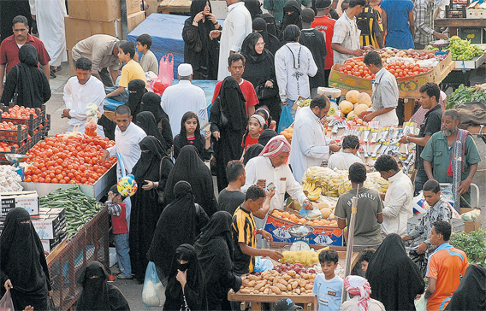
GDP
GDP: $921.7 billion
-petroleum 45% of this
- per capita $52,200

Slide 11
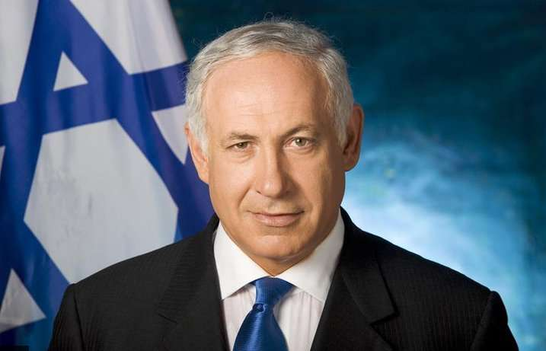
Economic System of Israel
Mixed, but mostly market
- Despite limited natural resources, Israelis have built an economy based on advanced technology
- The private and governmental sectors all coexist in an economy that supports both the broad objectives of state policy and individual enterprise (highly trained/skilled workers and strong union support of workers)

Slide 12
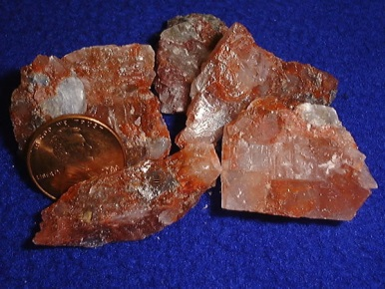
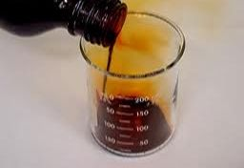
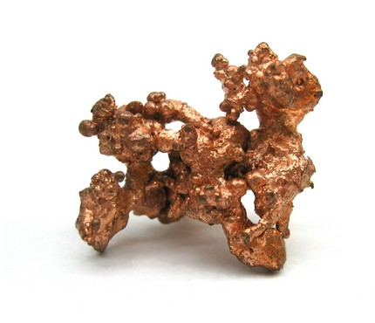
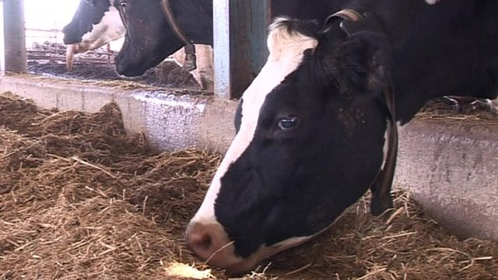
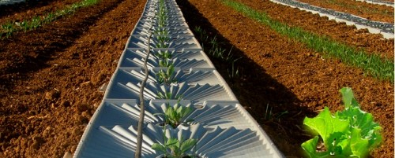
Natural Resources
Very limited natural resources!!
Mineral resources (potash, bromine, & magnesium; copper ore)
Citrus crops
Industrial crops
Dairy

Slide 13
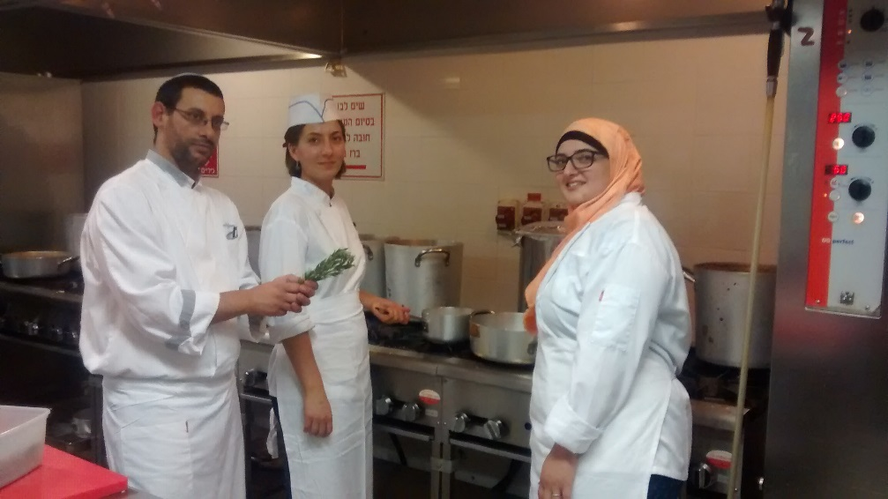
Human Capital
Invests a lot of money into education & has wide access to education; need highly educated work force for technology industry, mining, electronics, & services

Slide 14
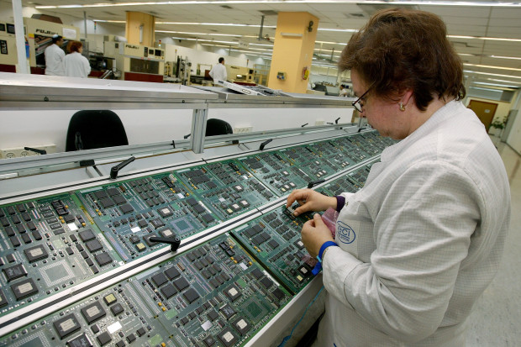
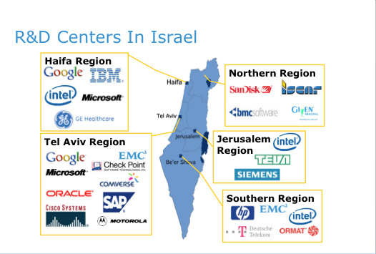
Capital Goods
Invested heavily in technology, tools, & equipment for technology & industrial production as well as defense/military

Slide 15
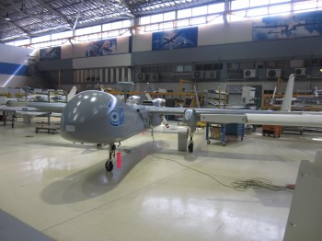
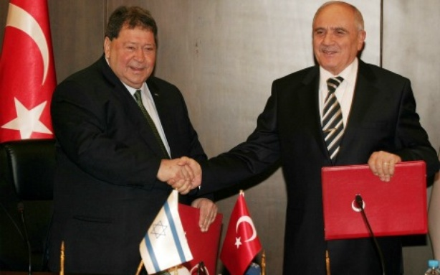
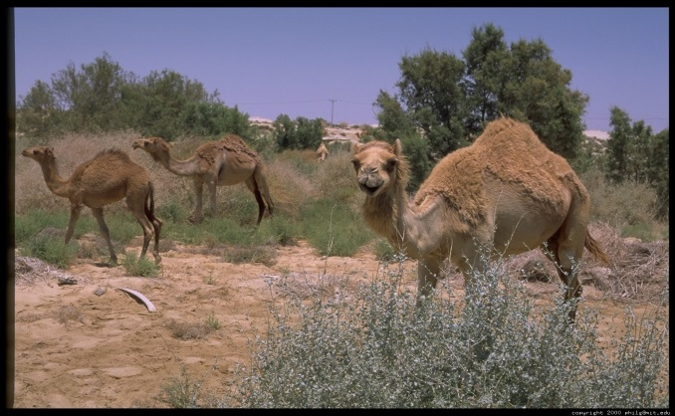
GDP
$240.9 billion
Mostly from Industries
Biggest Trade Partners-
European Union and U.S.
Lack of access to Middle East trade and imports mostly raw materials

Slide 16
Economic Systems of the Middle East
Learning Target: Describe the similarities & differences for the economic systems of Israel, Saudi Arabia, Turkey, & Iran

Slide 17
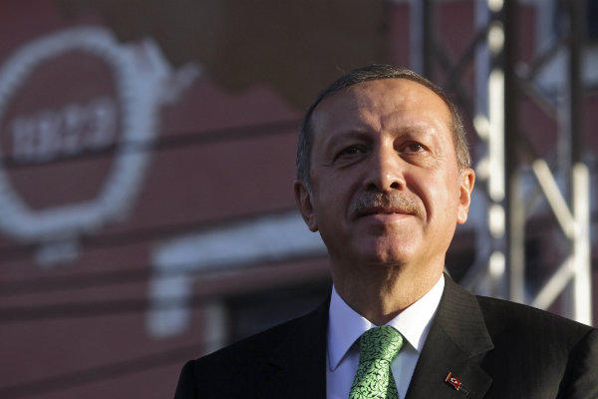
Economic System of Turkey
Mixed, but mostly command (emerging market)
- Private businesses have control and ownership over key industries. The government controls the airlines, railroads, telephone, and televisions industries.
- Least economic free out of three (Israel, Saudi Arabia, and Turkey)

Slide 18
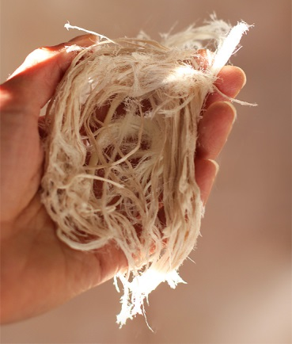
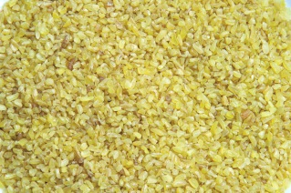
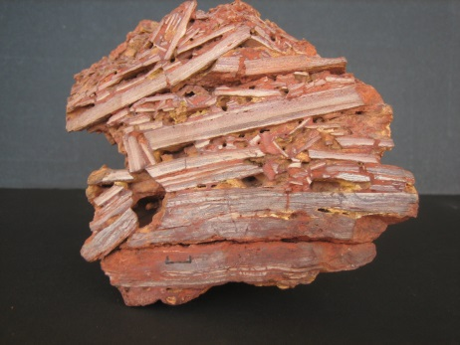
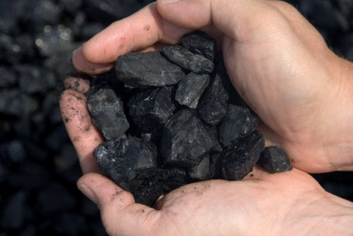
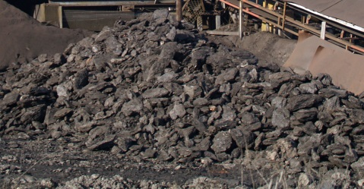
Natural Resources
Coal
Iron
Tobacco
Cotton
Grain
Olives
Manganese
Zinc
Lead
Copper
Bauxite
Lignite
Oil
Hydroelectric power

Slide 19
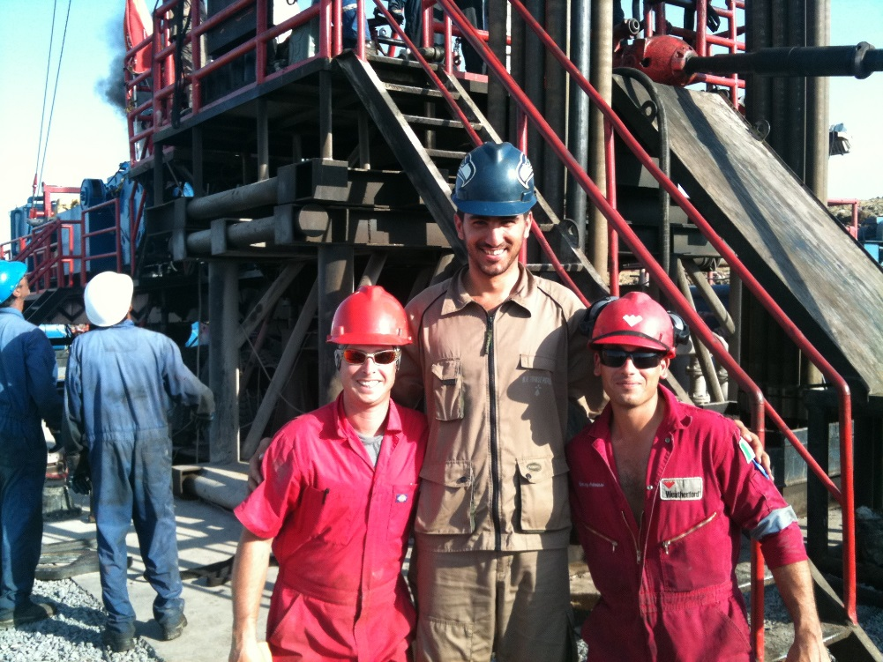
Human Capital
Invests heavily in education & training; literacy rate high, unemployment rate low

Slide 20
Capital Goods
Provide capital goods mainly for their textile & machinery industry

Slide 21
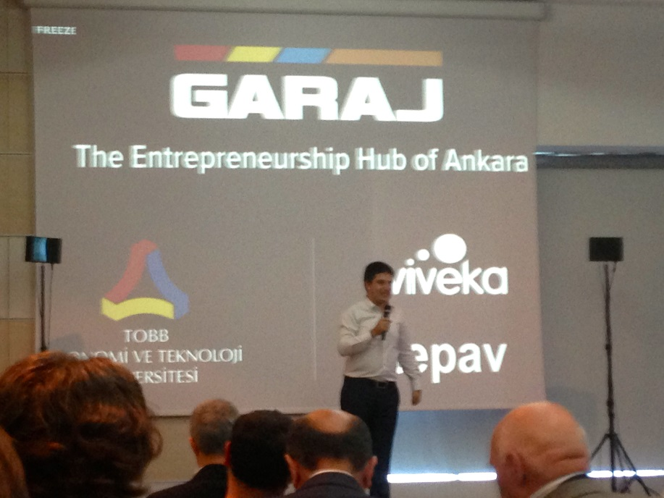
Entrepreneurs
Entrepreneurs & start up companies big in Turkey
Economic environment to make entrepreneurs successful

Slide 22
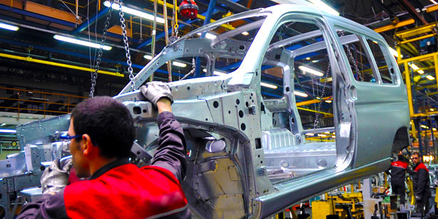
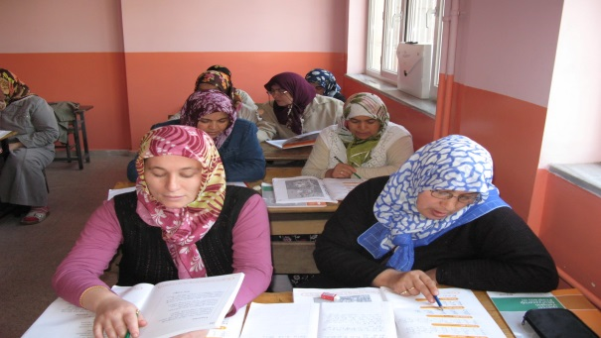
GDP
GDP per capita $15,200
17th largest globally
Literacy Rate: 87.4%
- Men: 95.3%
- Women: 79.6%

Slide 23
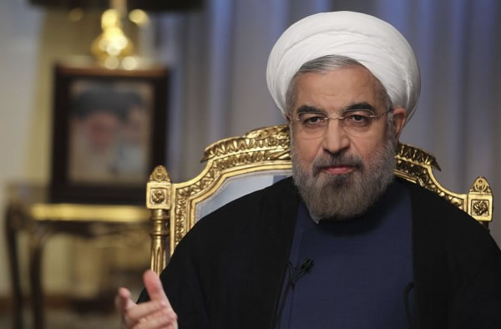
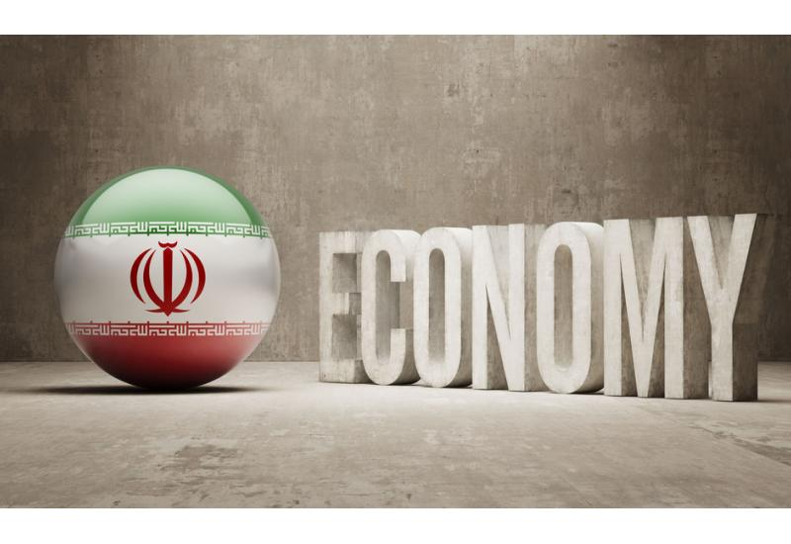
Economic System of Iran
Mixed but mostly command (large & expanding private sector
Not very efficient

Slide 24
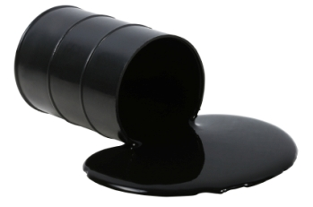
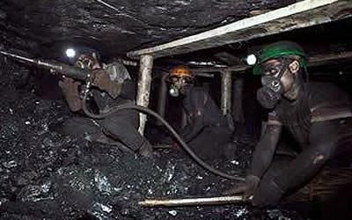
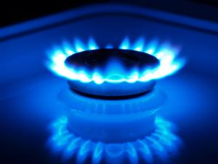
Natural Resources
Petroleum
Natural gas
Coal
Chromium
Other minerals

Slide 25
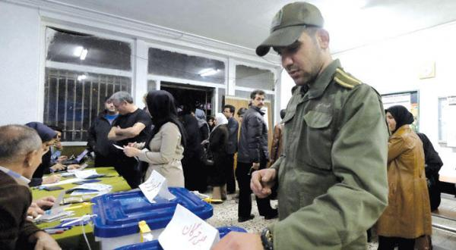
Human Capital
Even though there is oil wealth, many Iranians do not share in the money.
Focus on military

Slide 26
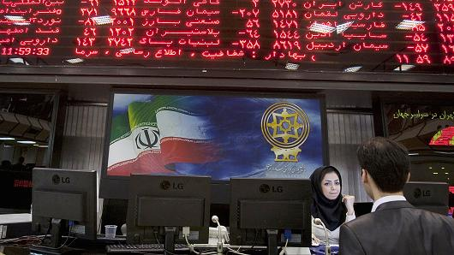
Capital Goods
Invests heavily in capital goods & funding for military

Slide 27
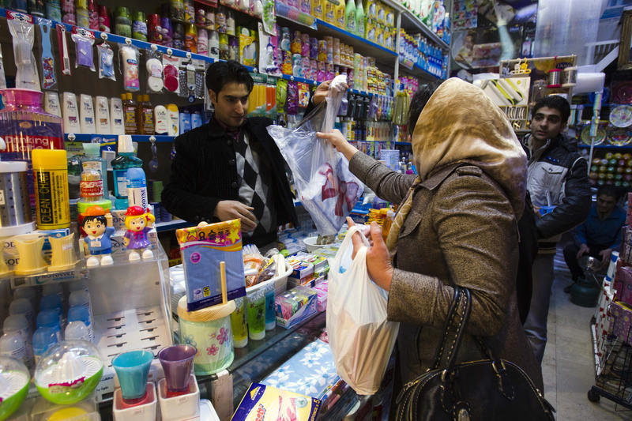
Entrepreneurs
Entrepreneurship a part of Iranian culture (small family owned shops, bazaars, etc…)
Government investment rising

Slide 28
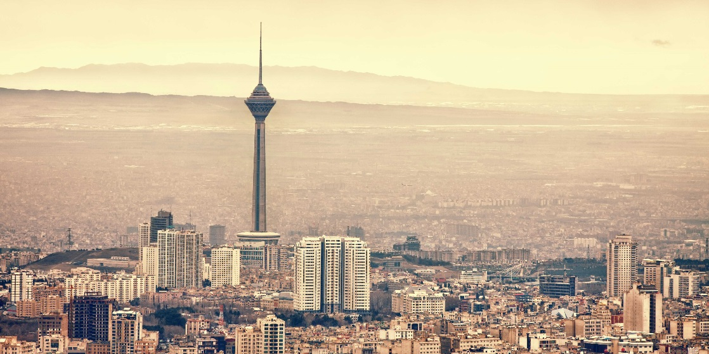
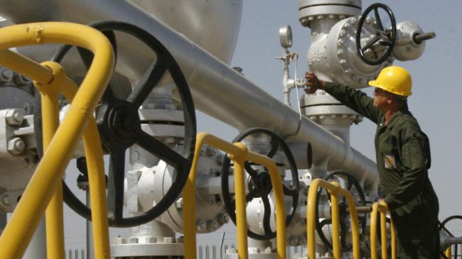
GDP
GDP per capita $13,300
18th in the world

Slide 29
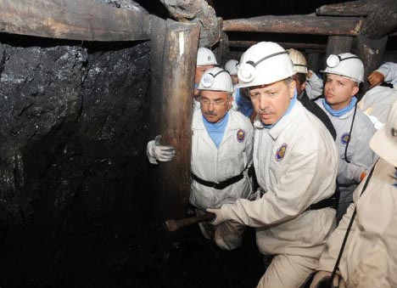
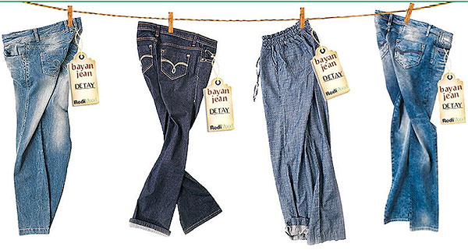
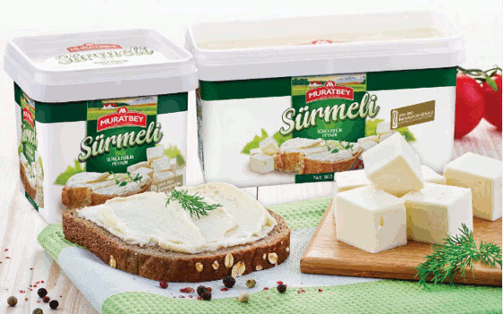
Main Exports & Industries
Industries: textiles, mining, steel, food processing, autos, and electronics
Main Exports: apparel, food, textiles, metal goods, and transport equipment
Main Trade Partner:
Germany and SW Asian Nations

Slide 30
SS7E5 The student will analyze different economic systems. A) Compare and contrast the economic systems of Israel, Saudi Arabia, and Turkey.
http://www.bbc.co.uk/news/18562596
Saudi Arabia

Slide 31
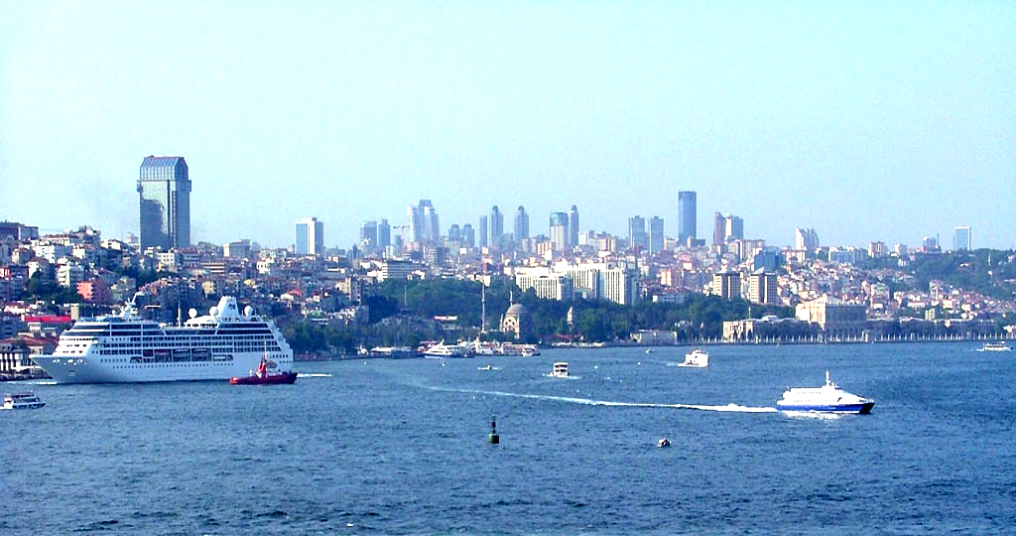
Background Info
CIA Factbook Information on Turkey’s economy
www.youtube.com/watch?v=9cgNRIvJnOs

Slide 32
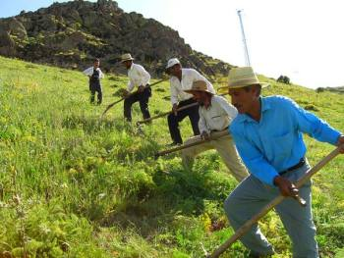
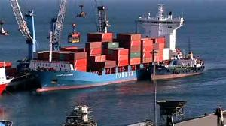
Main Source of Income
Service Industry (46%)
- Tourism growing
Agriculture (30%)
- Crops and livestock
Industry (24%)
- Manufacturing

Slide 33
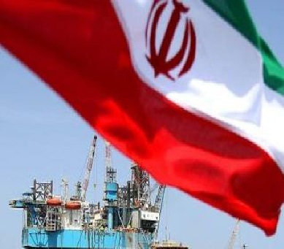
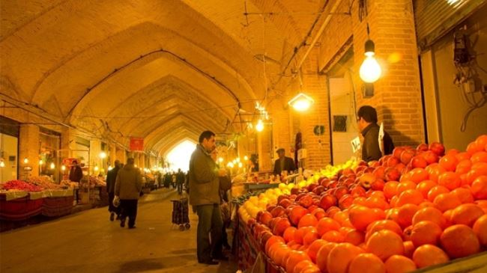
Iran
What to produce: Great oil wealth, but many Persians do not share in its wealth. Most money goes to military. Industry and Manufacturing also major part of exports
How to Produce: Economy continues to grow despite government attempts to keep tighter control
For Whom to Produce: Economy not efficient; hindered by complex restrictions and trade barriers/sanctions

Slide 34
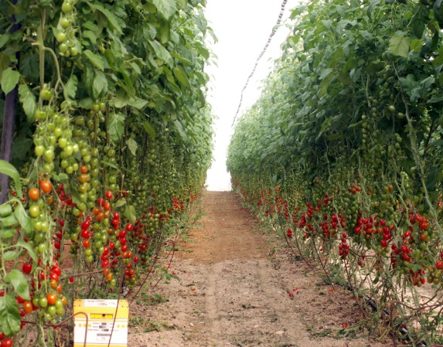
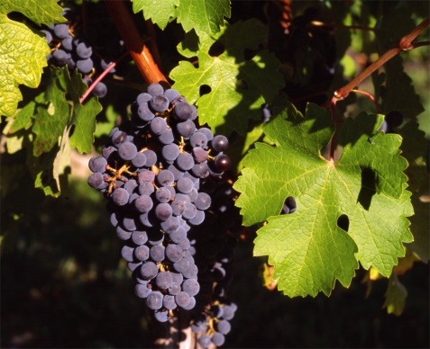
Main Source of Income
Agriculture: 2.5%
- Citrus & industrial crops
Industry: 31.4%
- High technology, science based
- Strong industrial sector: medical electronics, agro-technology, telecommunications, fine chemicals, and computer hardware/software
Services: 66.1%
- Tourism and Finance

Slide 35
Main Exports and Industries
Main Exports: machinery and equipment, software, cut diamonds, agricultural products, chemicals, textiles and apparel
Industries: high-technology products (including aviation, communications, computer-aided design and manufactures, medical electronics, fiber optics), metals products, & chemical products

