Slide 1
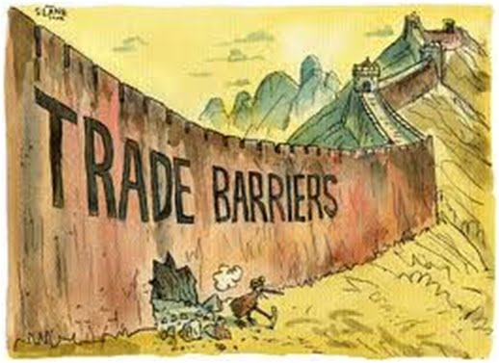
Trade Barriers
Something that restricts trade such as tariffs and embargos

Slide 2
Tariff
Percentage of money that usually goes to the gov.
Taxes placed on imported goods (items coming into the country)

Slide 3
Quota
Restrictions on the amount of a good that can be imported into a country.

Slide 4
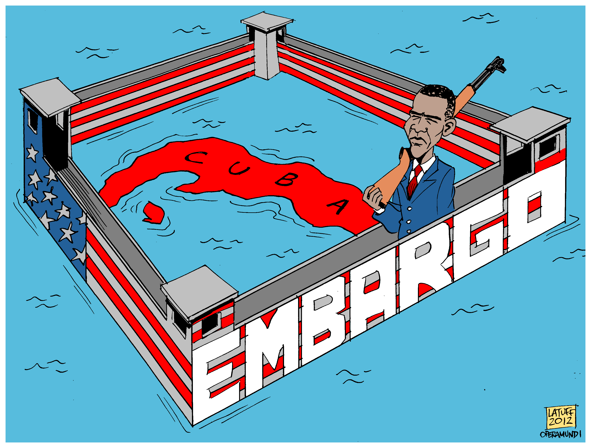
Embargo
A ban on trade with another country

Slide 5
Human Capital
The set of skills which an employee acquires on the job, through training and experience.

Slide 6
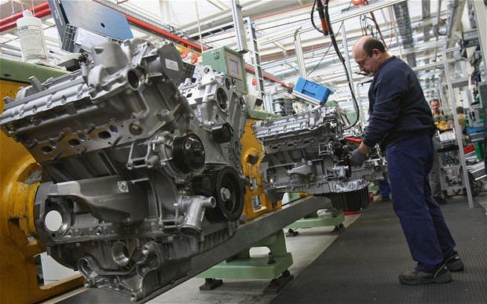
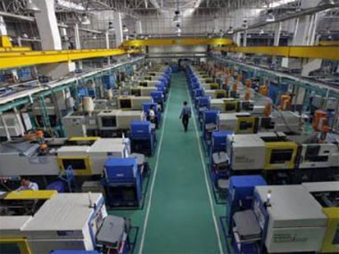
Capital Goods
Factories and machinery used to make a product

Slide 7
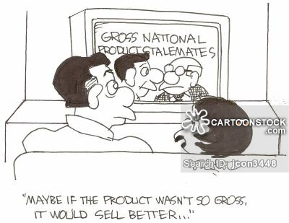
Gross Domestic Product
The GDP is the total market value of the goods and services produced by a country’s economy and compare it to other economies.

Slide 8
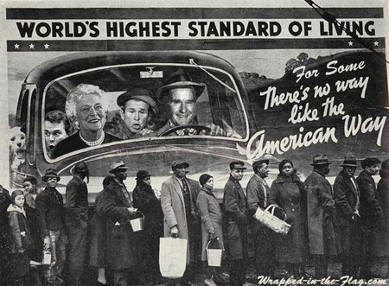
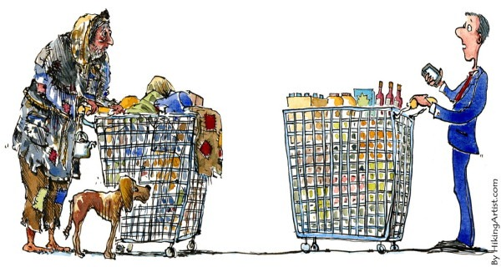
Standard of Living
a level of material comfort in terms of goods and services available to someone

Slide 9
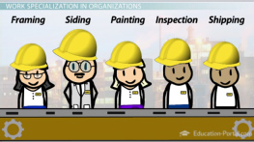
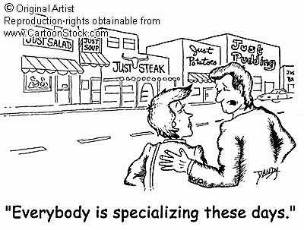
Specialization
Concentrating on one area of work.

Slide 10
Trade Barriers
Embargo
Specialization
Standard of Living
Tariffs
Human Capital
Quota
GDP/ Gross Domestic Products
Capital Goods

