Slide 1
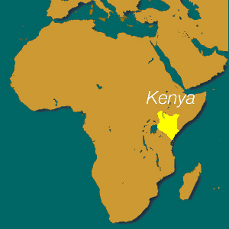
Government & Economy of Kenya

Slide 2
Type of Government
Presidential Democracy/ “republic”
“Democratic”(Citizen Participation)
Independence: Great Britain, 1963
Government recently switched from Presidential Democracy to Parliamentary Democracy (power & control issues)

Slide 3
Head of State/Government
President
Elected by National Assembly for 5 year term
Current President: Uhuru Kenyatta (son of 1st president)

Slide 4
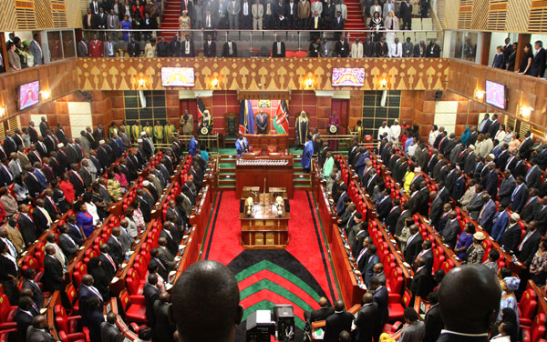
Legislature
The National Assembly & Senate (2 house/bicameral Parliament)
5 Year Terms
National Assembly votes for President (From majority party)

Slide 5
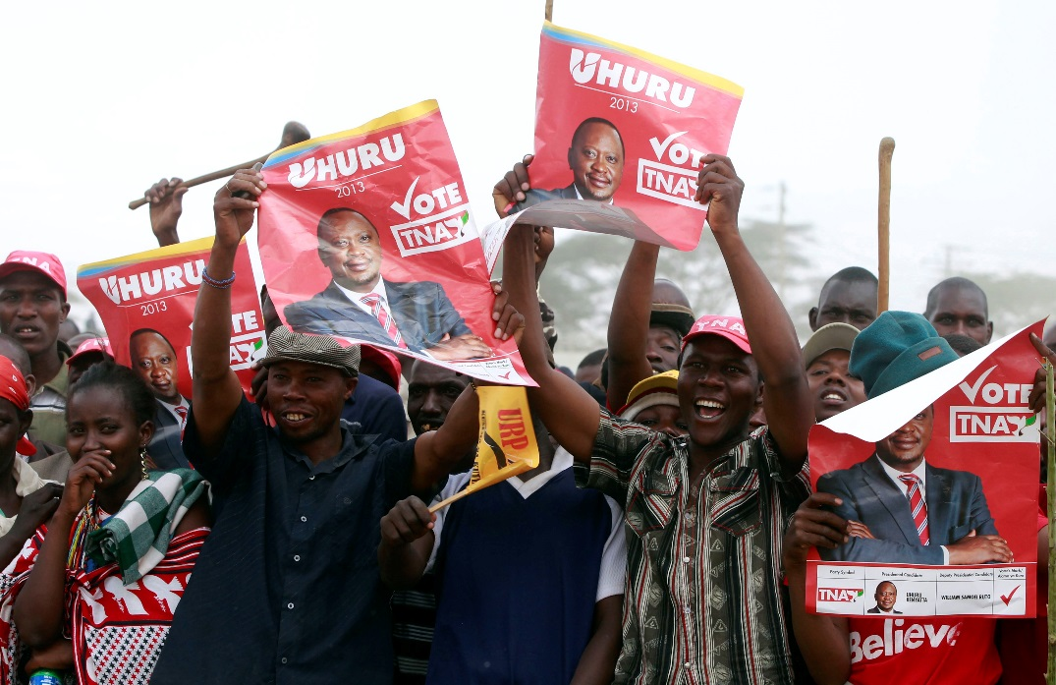
Voting Rights & Freedoms
Any & all citizens; 18+ years old
Freedoms in Constitution
President dominates Government (some improvement); Can restrict rights if necessary

Slide 6
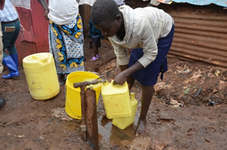
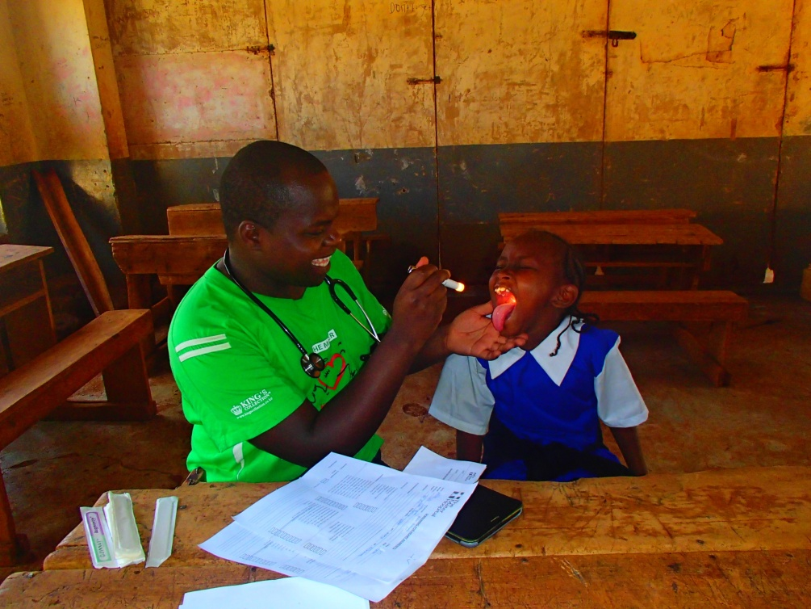
Disease
1,366,900 infected with HIV/AIDS; 8th globally
Higher Risk of Infectious Disease (malaria, typhoid, other water/food borne diseases)

Slide 7
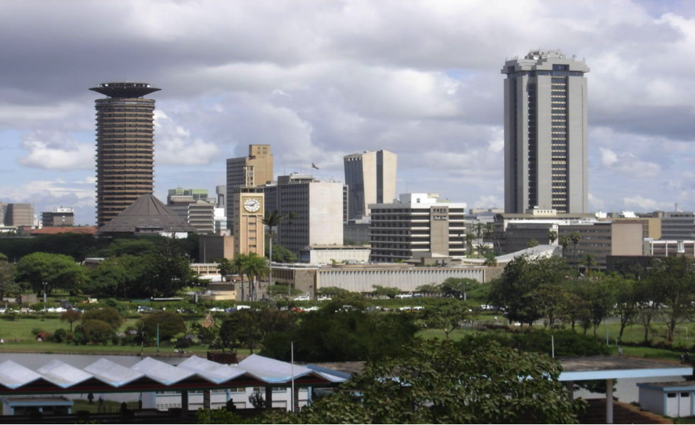
Economic System
Mixed but mostly market (some government control)
Government encourages entrepreneurship
Eastern and central Africa's hub for Financial, Communication and Transportation services

Slide 8
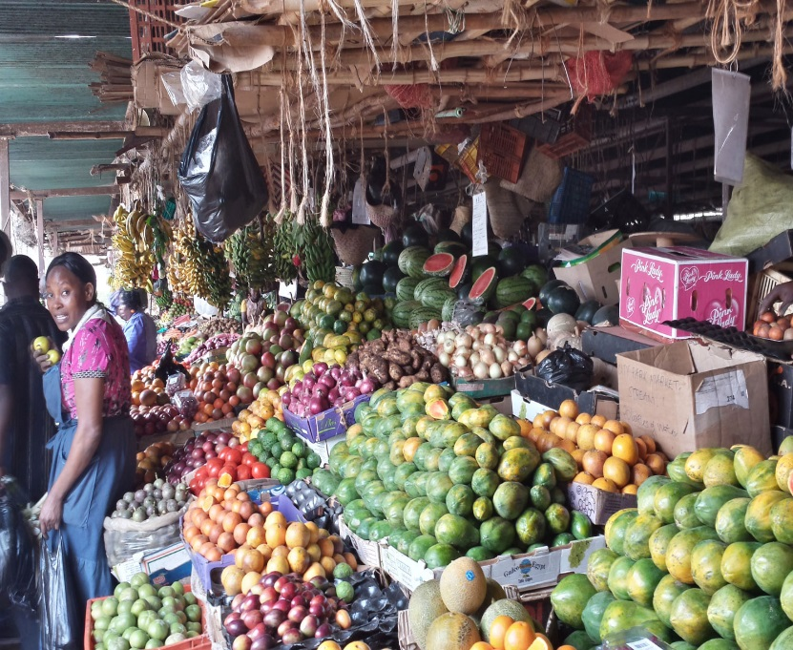
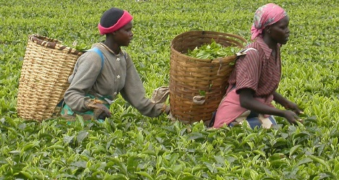
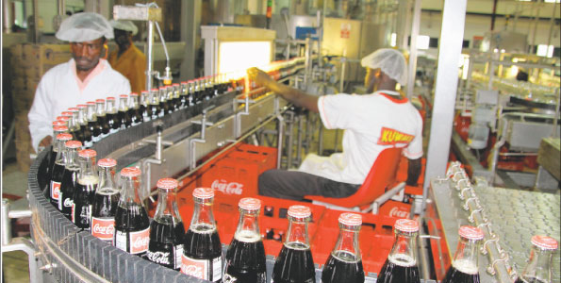
Goods Produced/Main Exports (What to Produce?)
Goods produced: Tea, Coffee, Small-scale consumer goods (plastic, furniture, batteries, textiles, clothing, soap, cigarettes, flour), & Agricultural products
Main Exports: Tea, Gardening & Farming products, Coffee, & Petroleum products

Slide 9
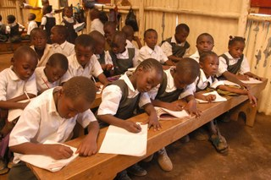
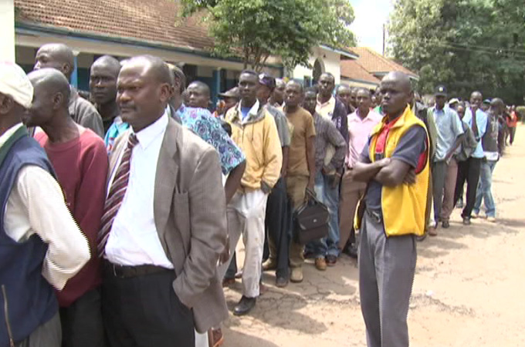
Human Capital
Invests heavily in skills and education for agriculture and agriculture products
Labor Force: Agriculture: 75%, Industry and services: 25%
Unemployment Rate: 40% (Education system/exams, migration to cities, seasonal jobs, & population growth)

Slide 10
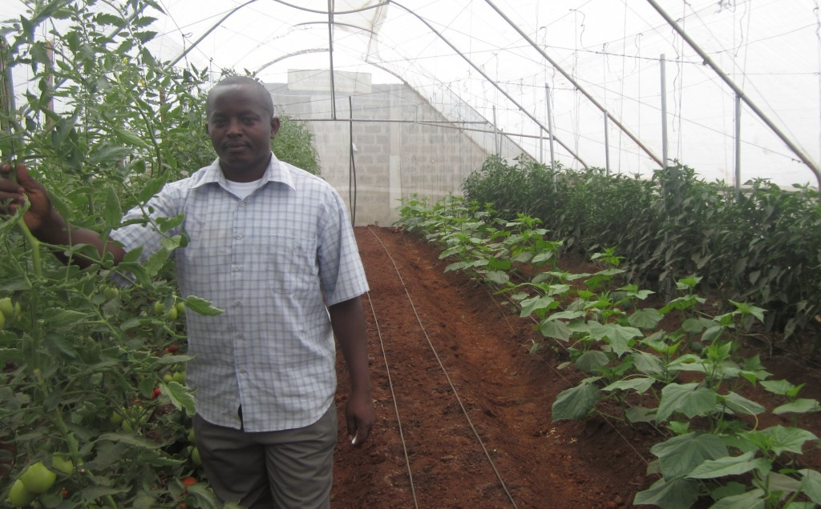
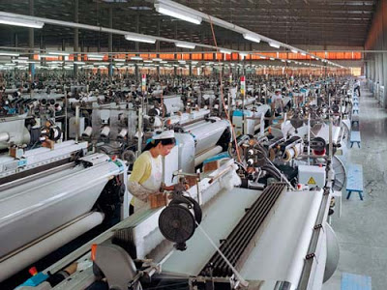
Capital Goods
Invests heavily in equipment needed for agriculture and manufacturing consumer goods

Slide 11
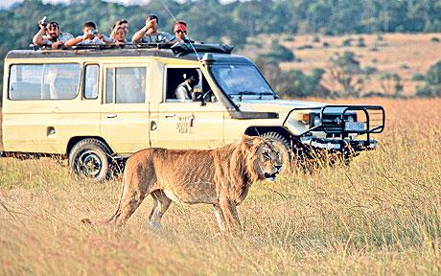
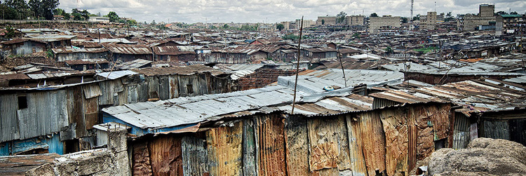
GDP/GDP per Capita
GDP: $60.94 billion
GDP per capita: $3,100
115th GDP in the world
Tourism 64% of GDP

Slide 12
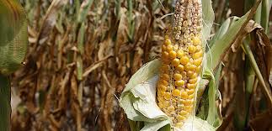
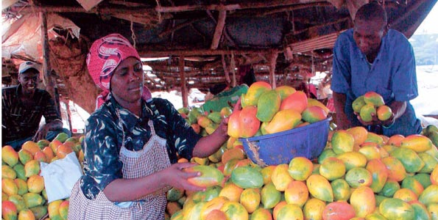
Trade Barriers
Sets Tariffs at 11%
On agricultural goods

