Slide 1
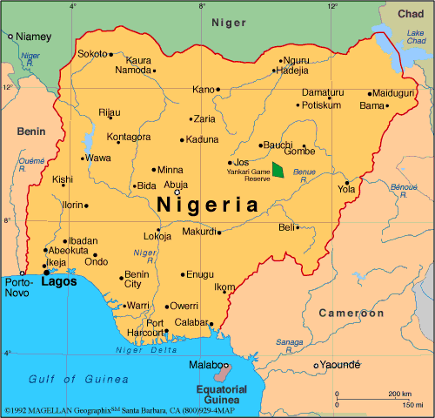
Government & Economy of Nigeria

Slide 2
Type of Government
Presidential Democracy
Democratic (Citizen Participation)
Independence: Great Britain, 1960
Previously Parliamentary Democracy; changed after series of coups or civil wars

Slide 3
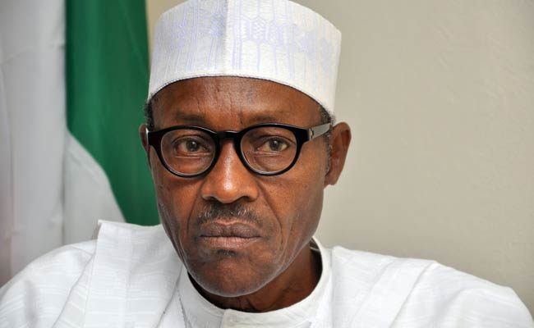
Head of State/Government
President
Elected directly by the people for 4 year term
Current President: President Maj. Gen. Muhammadu Buhar

Slide 4
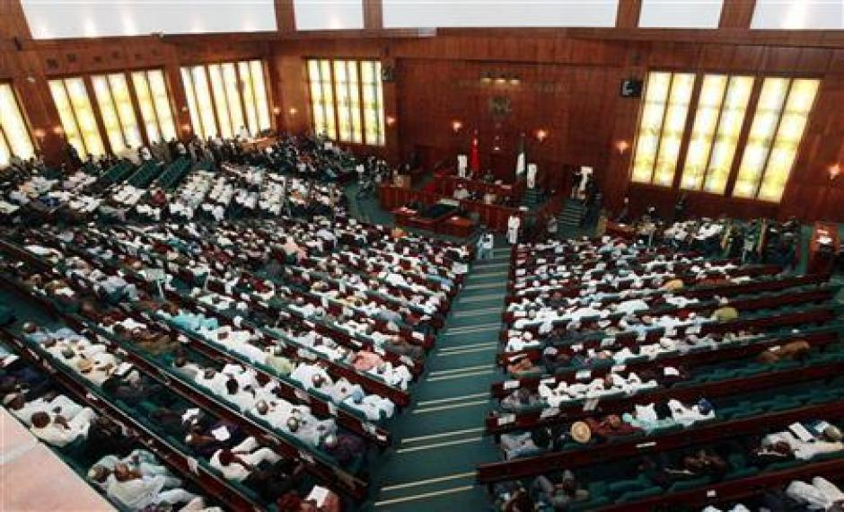
Legislature
Senate & House of Representatives (2 house/bicameral Congress)
4 Year Terms

Slide 5
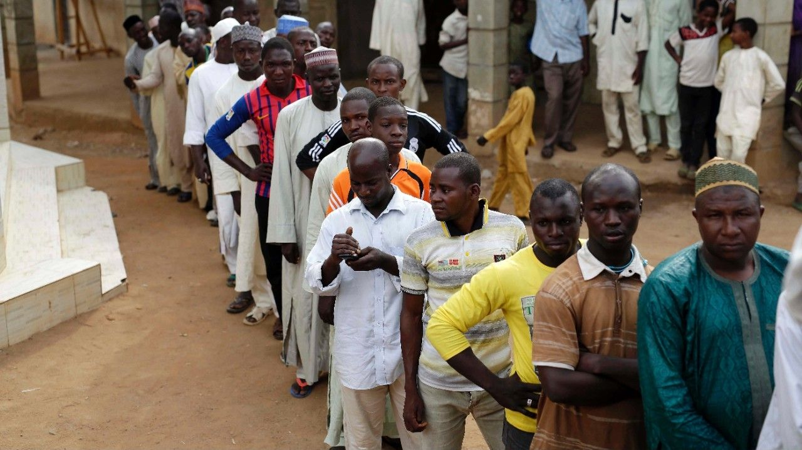
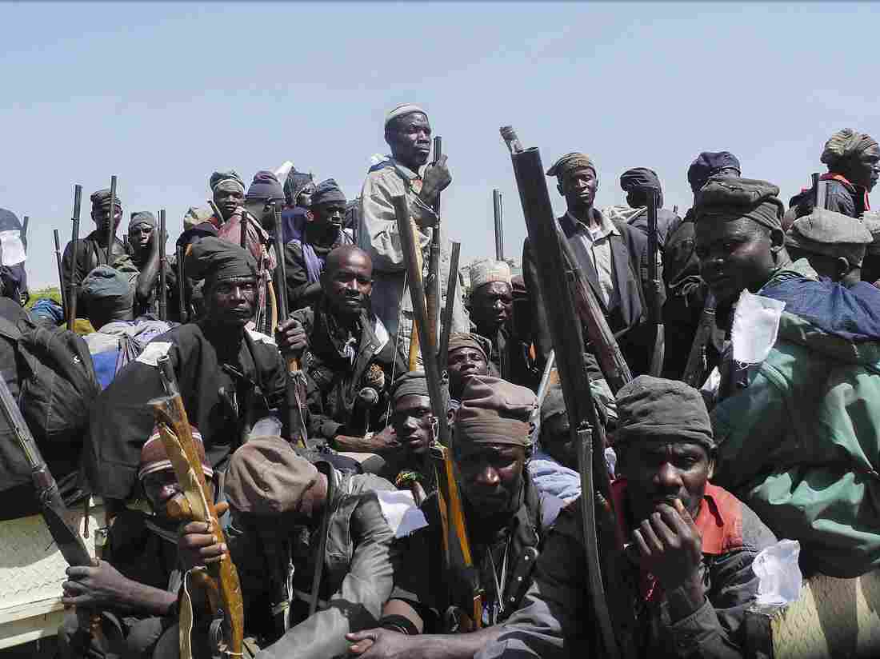
Voting Rights & Freedoms
Any & all citizens; 18+ years old
Partly Free
Government criticized for lack of response against Boko Haram (Islamic Militant Terrorist group-kidnappings, murders, etc..)
Limits in Freedom of Speech/Press

Slide 6
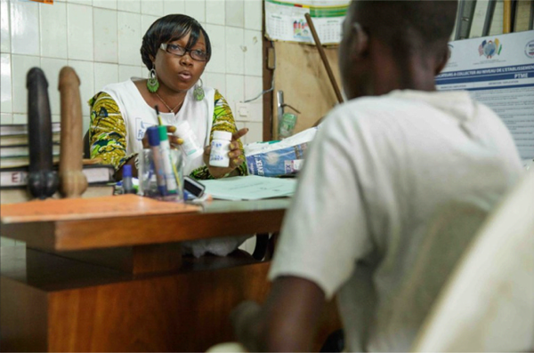
Disease
3,000,000 Nigerians infected with HIV/AIDS
Nigerian government didn’t make HIV/AIDs priority until 1990s (civil war and government corruption issues)
Government now makes prevention, treatment, & care main concern
Working to educate people & make treatment available

Slide 7
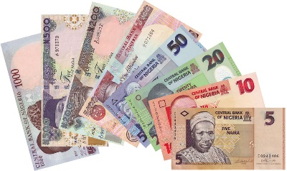
Economic System
Mixed but mostly Market transitioning from extreme government control)
Largest economy in Africa
Growth of economy & oil industry limited by inadequate power supply, lack of infrastructure/development, restrictive trade policies, insecurity, and government corruption.

Slide 8
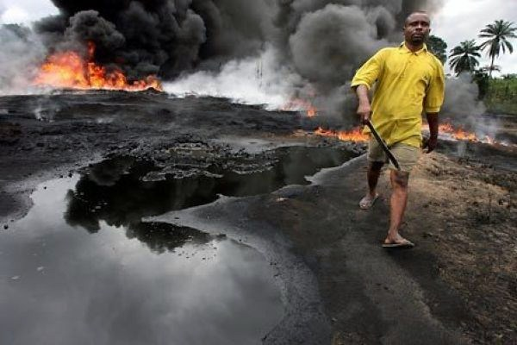
Goods Produced/Main Exports (What to Produce?)
Goods produced: Oil production & petroleum products (Member of OPEC)
Imports food products
46% of Nigeria’s daily oil production exported to the United States

Slide 9
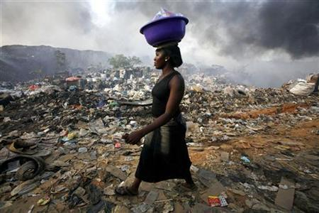
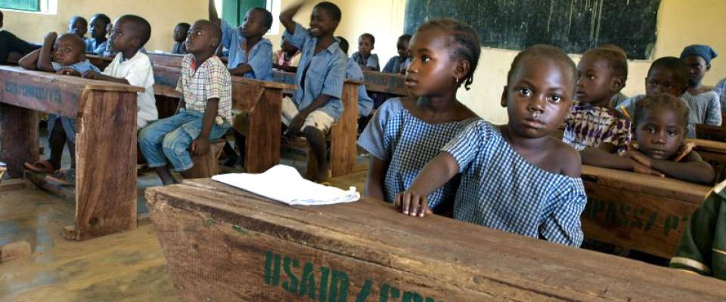
Human Capital
Very educated population
Lack of investment in job training, healthcare, decent pay, housing, & food supplies
Poverty Rate: 62%
Unemployment Rate: 4.9%

Slide 10
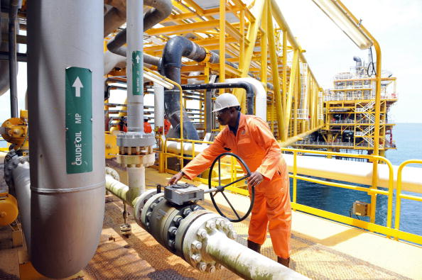
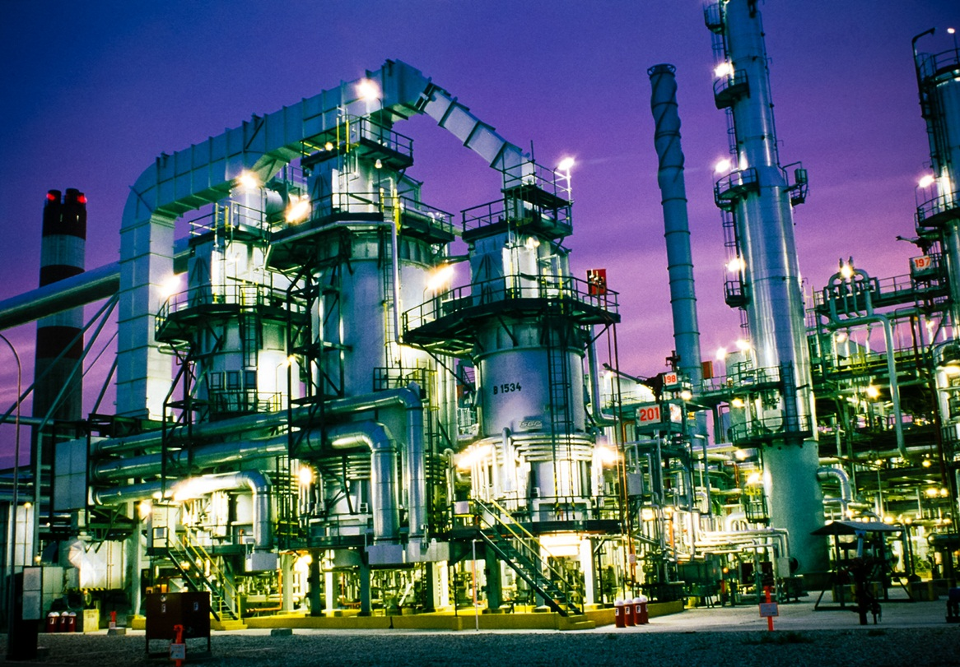
Capital Goods
Heavily invested in new technology for oil industry

Slide 11
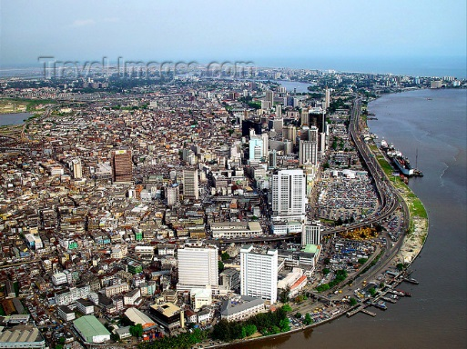
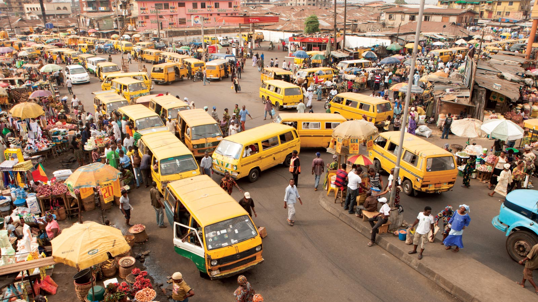
GDP/GDP per Capita
GDP: $1.105 trillion
GDP per capita: $6,400
Poorly organized after years of government corruption & dictatorship; trying to reorganize with more private business

Slide 12
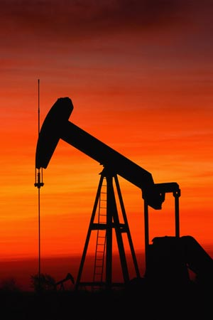
Trade Barriers
Nigeria member of OPEC
OPEC places quota on Nigeria’s amount of oil production
Quota regulate supply and price of oil; make as much money as possible

