Slide 1
Government Vocab

Slide 2
Autocracy
A government where the ruler has absolute power to do whatever he or she wishes and makes/enforces whatever laws chosen.
How government impacts citizen participation

Slide 3
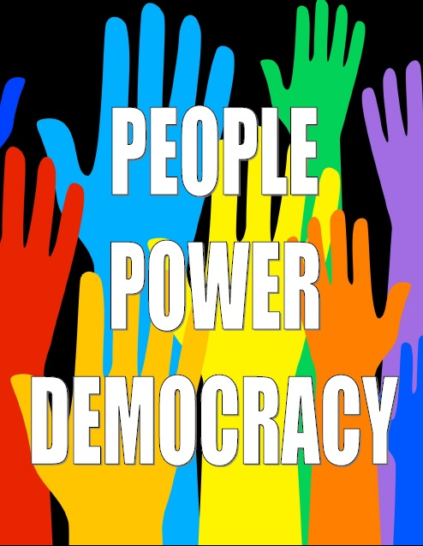
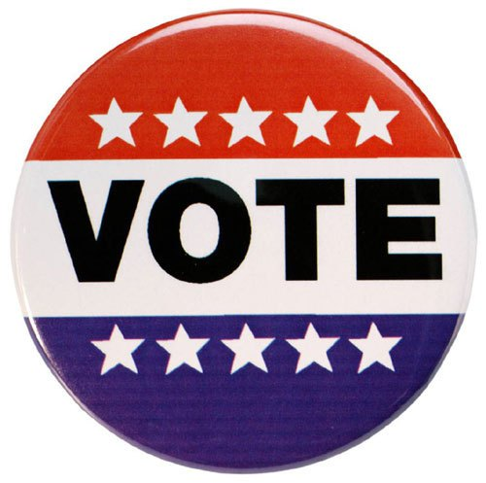
Democratic
A government system where people play a much greater role in deciding who rules and what decisions are made
How governments determine citizen participation

Slide 4
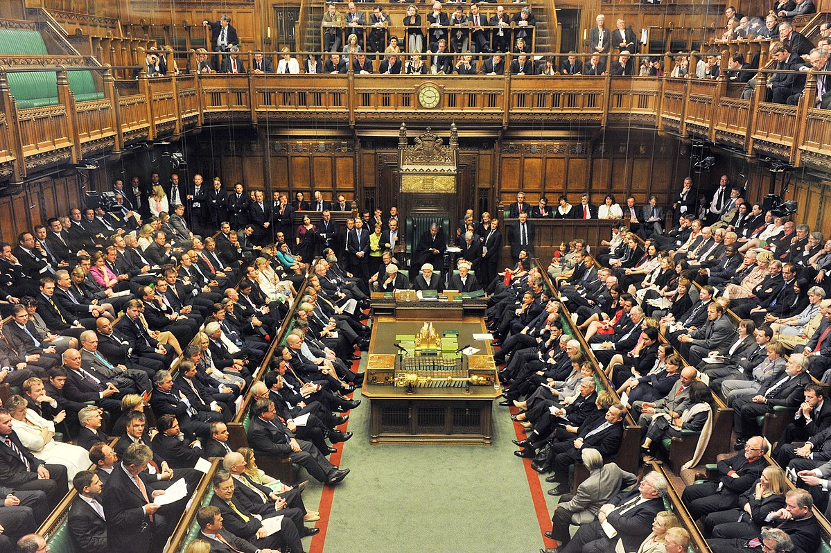
Parliamentary Democracy
Democratic system where Parliament is the legislature and the leader of the government, the Prime Minister, is the selected by the majority party in Parliament

Slide 5
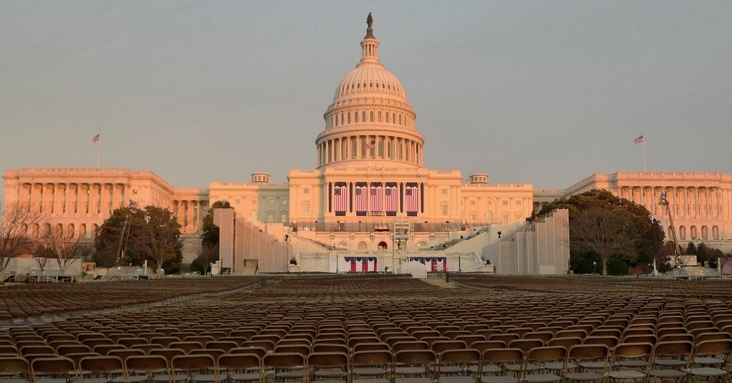
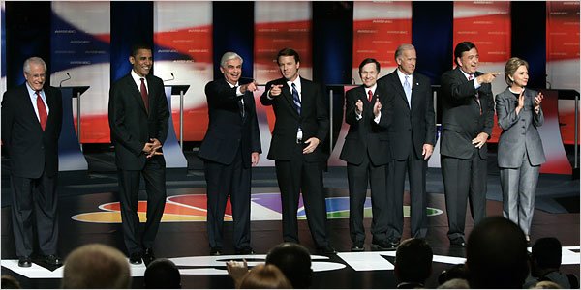
Presidential Democracy
Democratic system where Congress is the legislature and the leader of the government, the President, is voted in a separate election

Slide 6
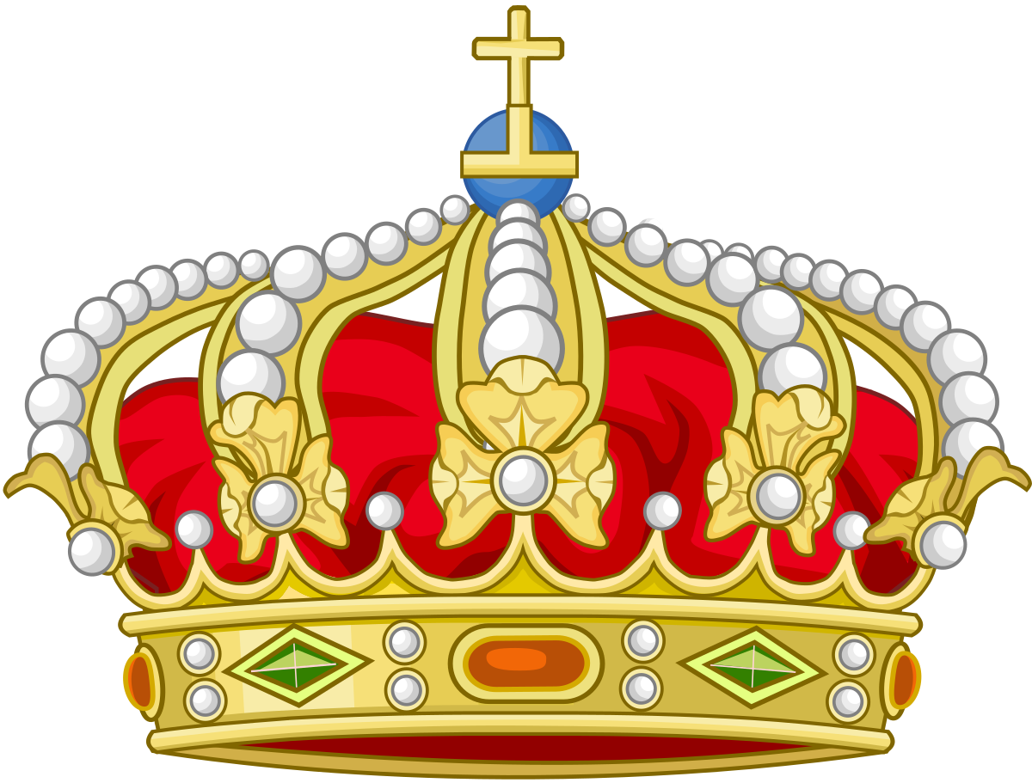
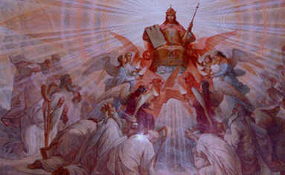
Absolute Monarchy
Hereditary ruler, king or queen, has “divine right”-God given right- to rule government and has total control/power

Slide 7
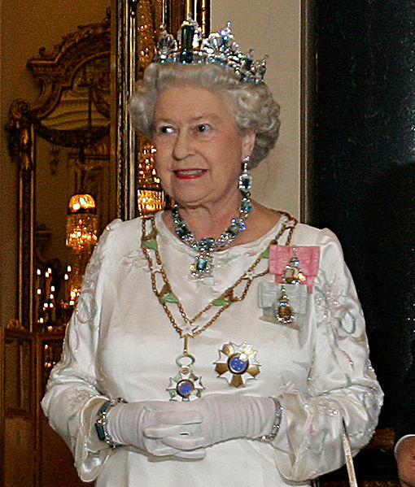
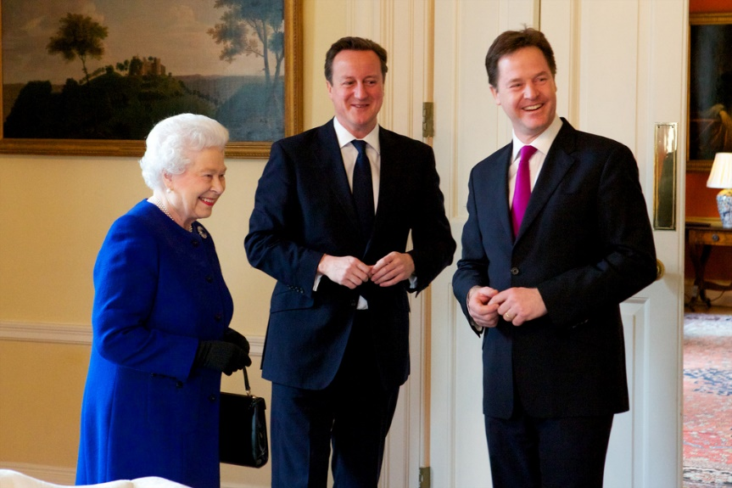
Constitutional Monarchy
Hereditary ruler, king or queen, rules as “figure head” of government; powers and ability to rule limited by constitution

Slide 8
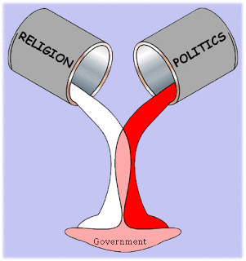
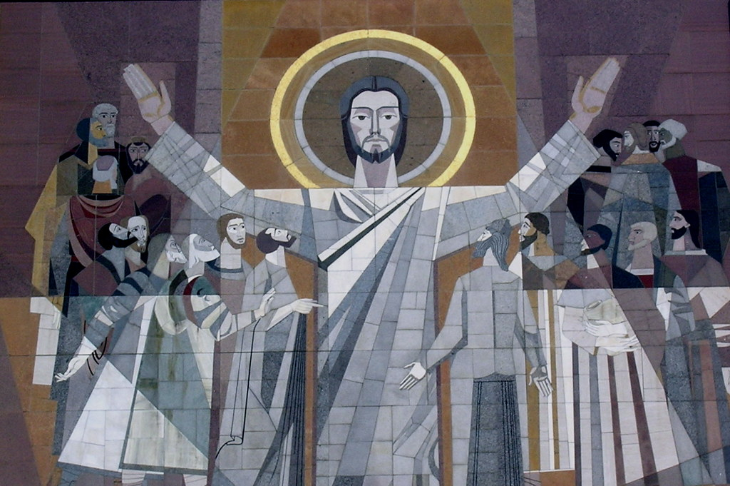
Theocracy
A government where the laws are based on religion and the god/gods are technically the head of the government with the ultimate political authority.
This Photo by Unknown Author is licensed under CC BY-NC-ND
This Photo by Unknown Author is licensed under CC BY-NC

Slide 9
Representative
An elected official who works in the government for their area (town, county, state, etc.)

Slide 10
Checks + Balances
When the power of a government is shared among different parts

Slide 11
Theocracy
Autocracy
Absolute Monarchy
Democracy
Presidential Democracy
Parliamentary Democracy
Constitutional Monarchy

