Slide 1
History of Southern & eastern Asia Vocabulary

Slide 2
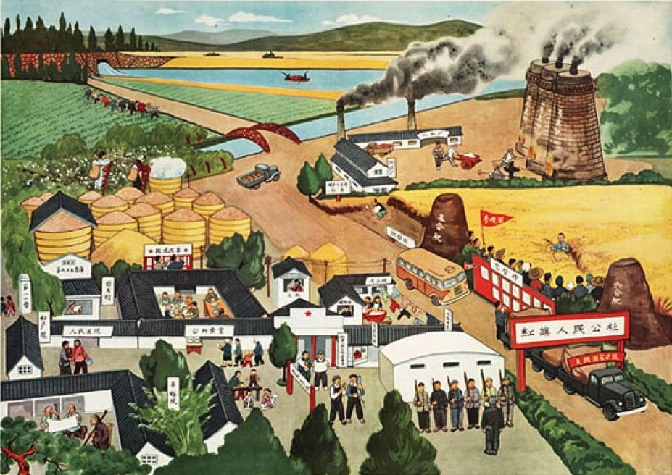
Great Leap Forward
Organizing farms into “collectives” where ownership/decisions are made by government

Slide 3
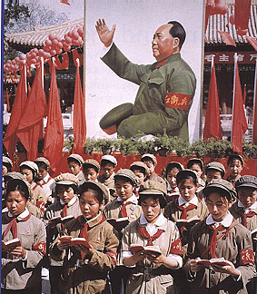
Cultural Revolution
A war on anything in Chinese society that encouraged class differences or promoted old Chinese ideals/beliefs

Slide 4
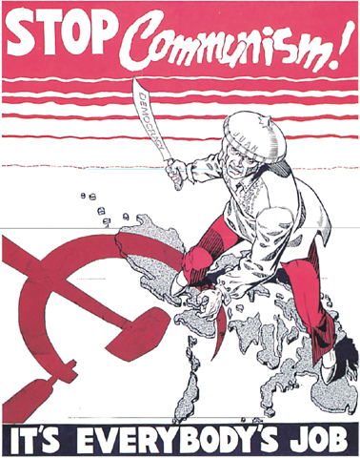
Containment
The action or policy of preventing the expansion of communism.

Slide 5
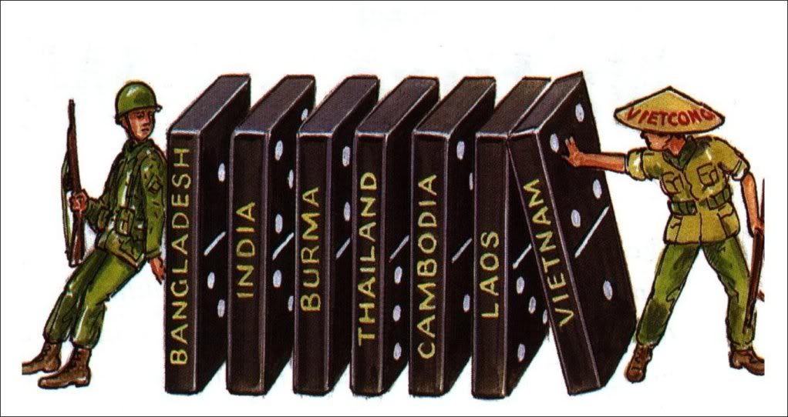
Domino Theory
The belief that if one country fell to communism, all the others nearby would fall as well

Slide 6
Containment
Communism
The action or policy of preventing the expansion of communism.
A government/economic system that promotes a classless society based on common ownership of products and property

Slide 7
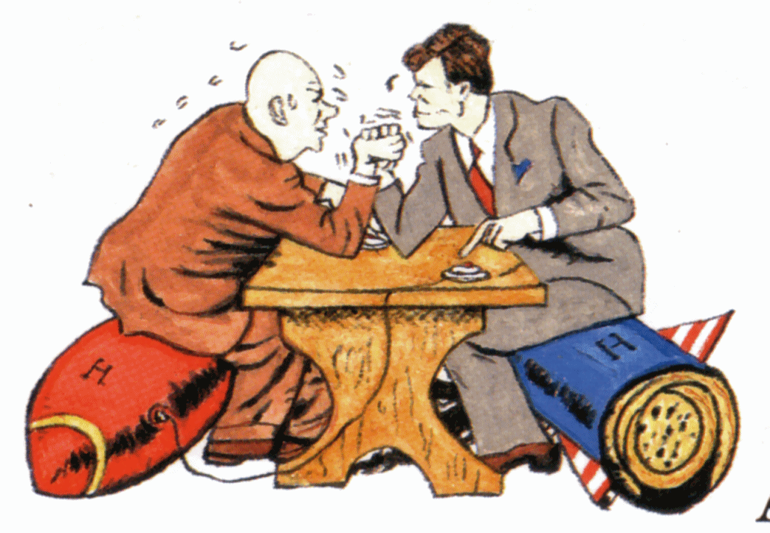
Cold War
Domino Theory
A period of extreme tension, but no fighting, between the United States & the Soviet Union
The belief that if one country fell to communism, all the others nearby would fall as well

Slide 8
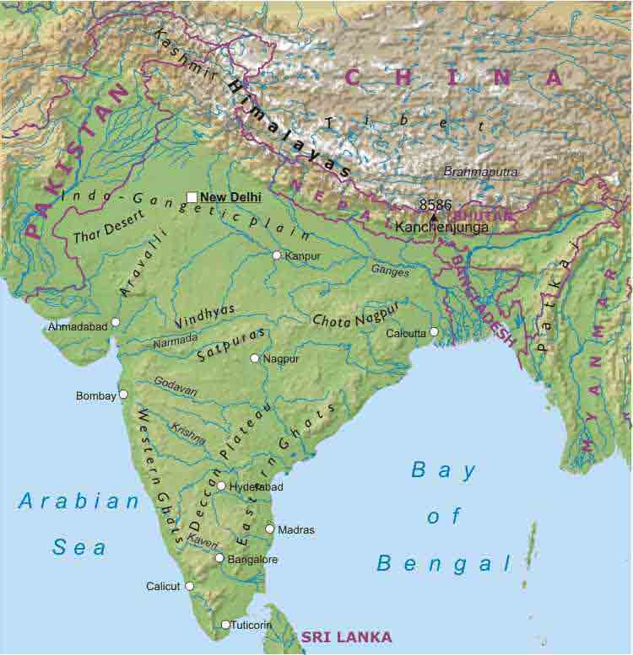
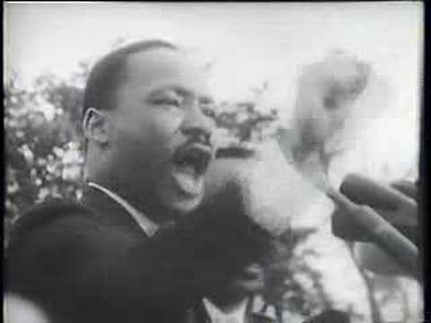
Civil Disobedience
Subcontinent
The non-violent refusal to obey an unfair law even if the result was punishment
A division of a continent by physical features

Slide 9
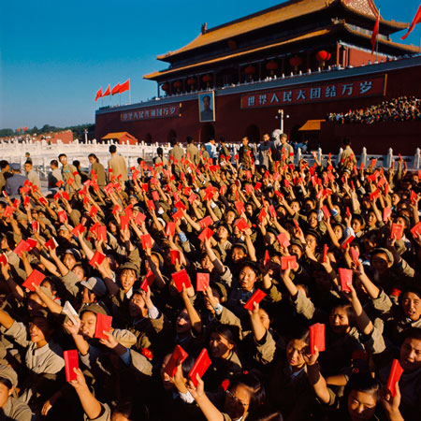
Cultural Revolution
Red Guards
A war on anything in Chinese society that encouraged class differences or promoted old Chinese ideals/beliefs
Students who were organized into an army to implement the “Cultural Revolution”

Slide 10
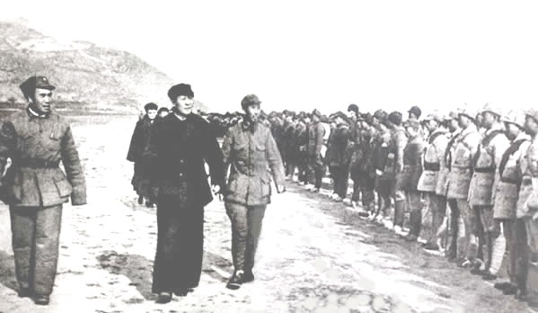
Red Army
Great Leap Forward
Mao Zedong’s communist supporters/fighters
Organizing farms into “collectives” where ownership/decisions are made by government

Slide 11
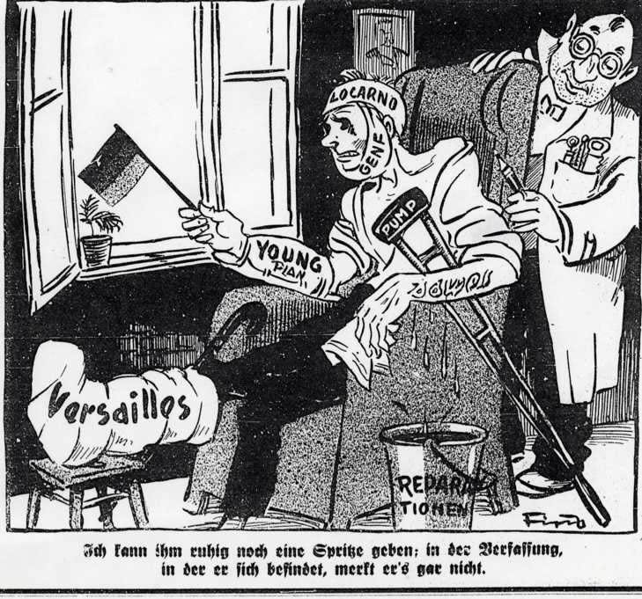
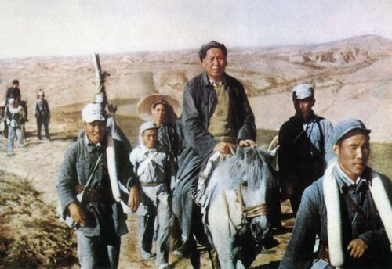
Reparations
Long March
Payment for damages
The 6,000 mile journey of Mao Zedong and his followers to the mountains to avoid capture for their communist cause

Slide 12
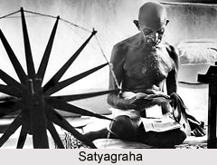
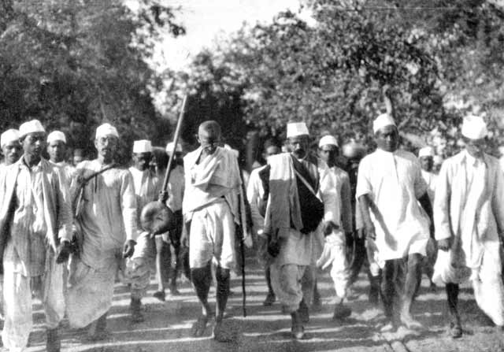
SATYAGRAHA
SALT MARCH
Gandhi’s form of nonviolent protest used by him and his followers during their fight for independence
Nonviolent protest in 1930 where millions of Indians boycotted the British salt by marching to the sea && making their own

Slide 13
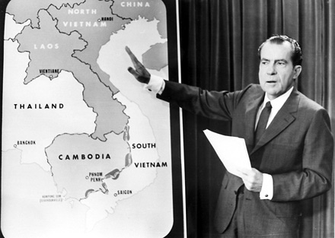
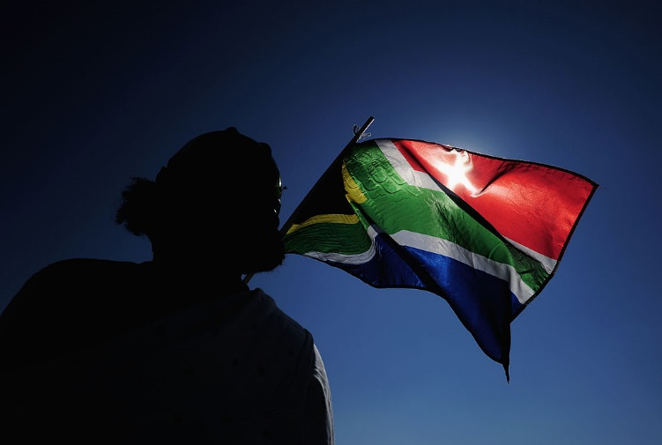
VIETNAMIZATION
UNIFIED POLITICAL IDENTITY
Strategy used by the U.S. where the war was turned over to the Army of South Vietnam
Building nationalism among ethnic groups in order to build a country

