Slide 1
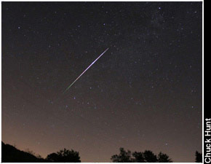
Meteor
Sometimes called a “Shooting Star”
When a meteorite enters Earth’s atmosphere, friction causes them to burn up, producing a streak of light

Slide 2
Comets
Bodies in space made up of ice, dust, small gritty particles
Sometimes called “dirty snowballs”
When close to the sun, ice vaporizes, producing a spectacular streak of gas, referred to as a “tail”
Many in a regular orbit around the sun

Slide 3
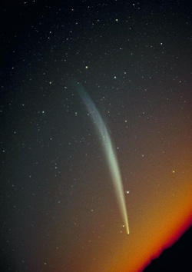
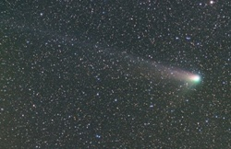
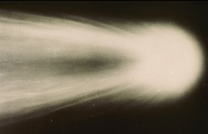
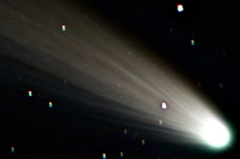
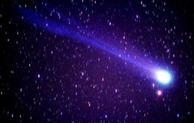
Comets

Slide 4
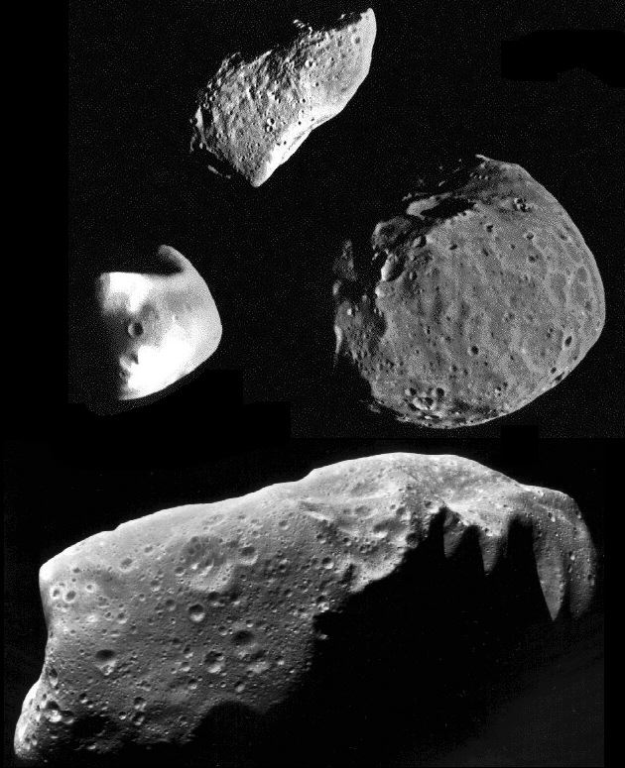
Asteroids
An irregularly shaped rocky object in space (like a space potato)
May be the shattered remains of objects left over from the time when the planets were formed

