Slide 1
Middle East Project

Slide 2
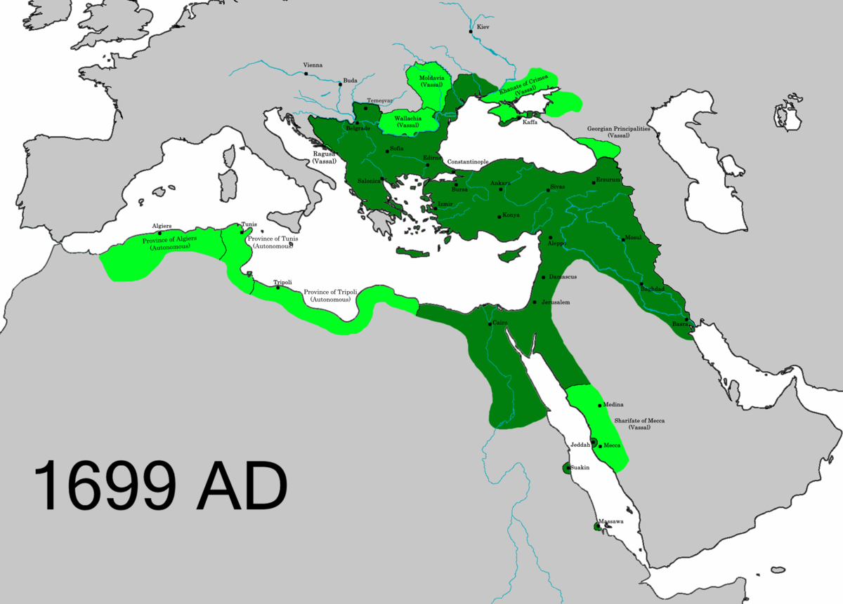
Ottoman Empire

Slide 3
European Partition

Slide 4
Israel

Slide 5
Palestine

Slide 6
USA

