Slide 1
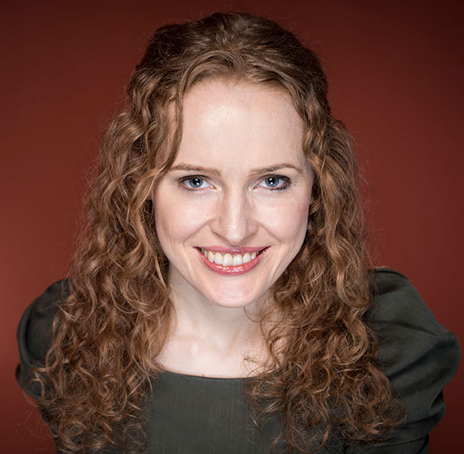
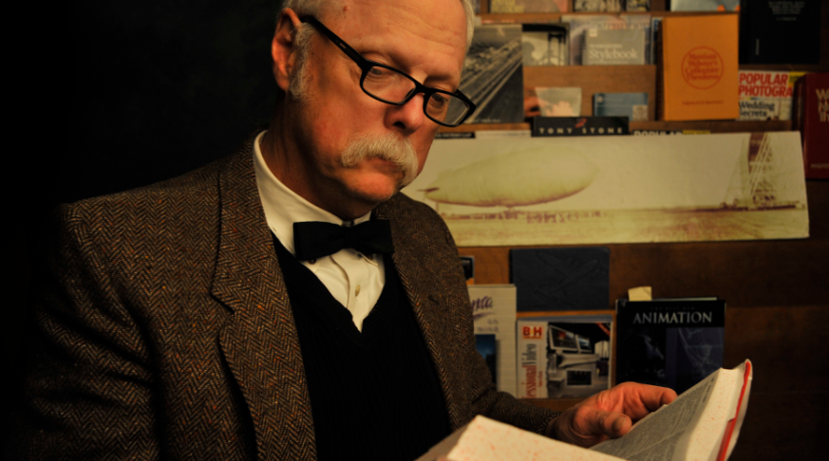
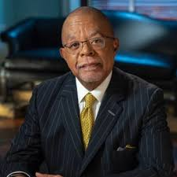
Thinking Like a Historian

Slide 2
Activator
“Those who cannot remember the past are condemned to repeat it.”
What does this quote mean to you?
What does it say about the importance to study the past?

Slide 3
Learning Target
I will describe the skills and tools needed to study History.

Slide 4
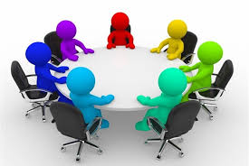
Work Session
Go to “Lesson Assignments” and down load a copy of the Guided Notes.
Take notes as we discuss the topic “Thinking Like a Historian.”

Slide 5
What’s a “historian”?
Answer: A student or writer of history
Example of “historian” used in a sentence:
In considering who’s the greatest president, historians take into account many different considerations.
Notes:
Definition per Merriam-Webster: https://www.merriam-webster.com/dictionary/historian

Slide 6
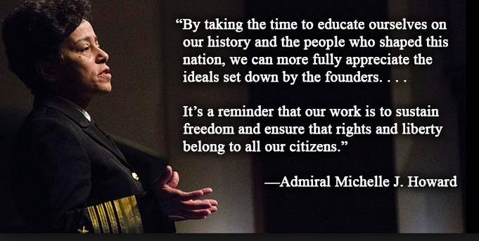
Why do we care about history?
To better understand what’s happened in the past
To use our learnings about the past in order to:
Avoid repeating undesirable events and scenarios
To help us better predict the future

Slide 7
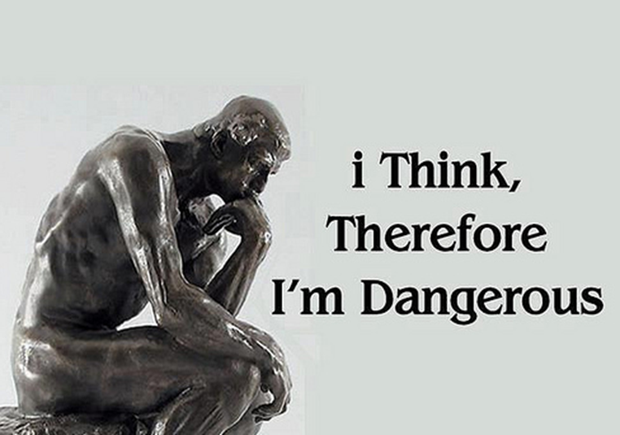
Why it’s important to think like a historian?
To determine the accuracy, or inaccuracy, of information that we’re presented with
Use information that is based on FACT(S)
Be able to better form our own opinions by using factual information
So that we’re less able to be swayed, or influenced, by others

Slide 8
Vocabulary
SOURCE
Where something comes from (this source of a river; the source of a book)

Slide 9
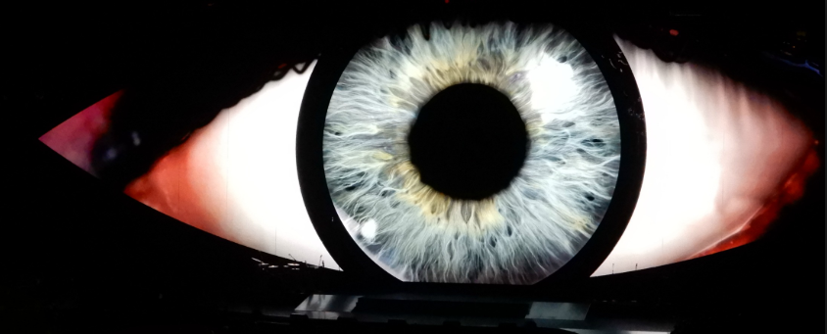
Vocabulary
PRIMARY SOURCE
Definition: Someone who was present during an event

Slide 10
Vocabulary
SECONDARY SOURCE
Definition: Someone who wasn’t present at an event and uses information provided by primary sources to describe what happened
A secondary source is NOT a witness

Slide 11
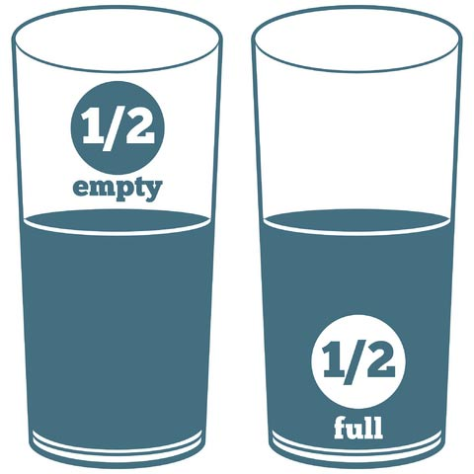
Vocabulary
POINT OF VIEW
Definition: Opinion or beliefs that change how you see something.

Slide 12
CONTEXT
What was going on in the world when the event occurred?
How were things different then?
How might this have impacted the author’s point of view of the event?

Slide 13
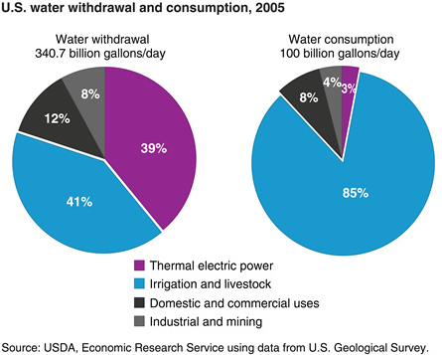
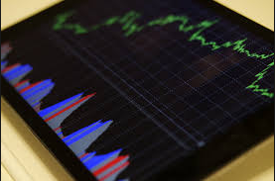
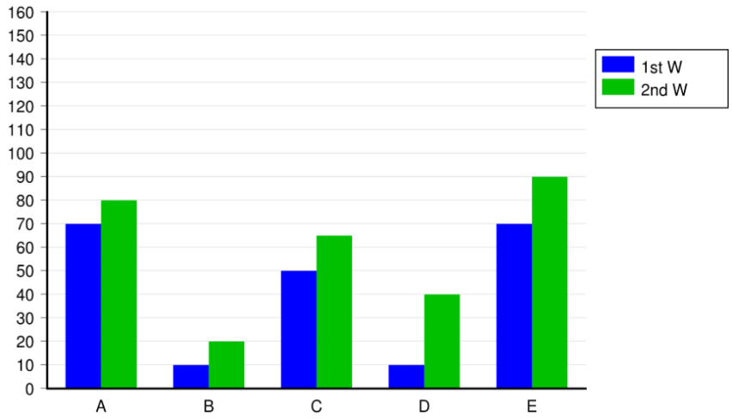
Organizing INFORMATION

Slide 14
There Are Many Ways to Organize Information
Some of the most common are:
Outlines
Reports
Databases
Visuals such as graphs, charts, maps, timelines, etc.

Slide 15
Importance of Organizing Information
It becomes easier to quickly retrieve info you’re looking for
Whenever you search for something online, chances are you use Google – Why?
Google has made it easy to quickly obtain the info you’re searching for
It also becomes easier to sort and categorize your information and then translate that info into an easy-to-follow story
Notes:
Last slide of Day 1

Slide 16
ANALYZING INFORMATION
Notes:
First slide of Day 2

Slide 17
Importance of Analyzing Information
Helps us to better understand the present and predict the future
Also, allows us to:
Identify cause and effect relationships
Compare and contrast
Identify the main story of an event and summarize it
Draw conclusions

Slide 18
Predicting the Future
By being able to skillfully analyze information, we are better able to predict what will happen in the future
Can you think of any professions where its their job to try and predict the future?

Slide 19
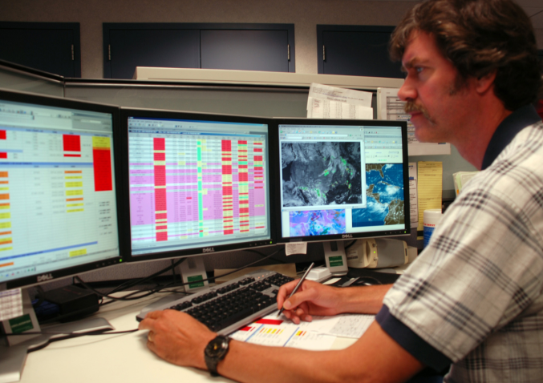
Predicting the Future
Weather meteorologists are a good example of a profession where it’s someone’s job to try and predict the future
In this example, meteorologists use a large amount of information, analyze it, and then create their weather forecast (prediction)

Slide 20
Predicting the Future
How might we be able to use history to help us predict the future?
By understanding how and why things happened in the past, we are better able to predict if, or when, similar occurrences will happen in the future
If we don’t learn from the past, we are likely to repeat it

Slide 21
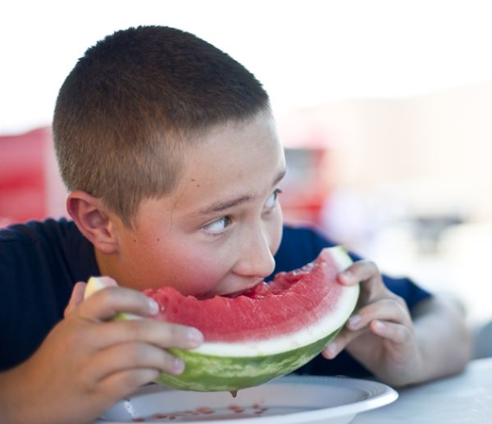
Cause and Effect
If you eat healthy, you’ll grow big and strong!
This statement is an example of a cause and effect relationship
Eating healthy is the cause
Growing big and strong is the effect of eating healthy

Slide 22
Comparing & Contrasting
This is when we analyze the similarities and differences of something
We compare things when we explain two or more characteristics/traits that something has in common with something else
Examples of comparative words: both, like, as well, same, similar, etc.
We contrast things when we explain two or more characteristics/traits that make something different from something else
Examples of contrasting words: although, instead, however, meanwhile, whereas, etc.

Slide 23
Main Story & Summarizing
Whenever we analyze something, it’s important to be able to explain the stories main point while summarizing it clearly and concisely
To do so, we:
Identify the main story
This is usually in the first or last sentence of the first paragraph of a story
Focus on information that supports the main story
Summarize the story in your own words, in ONE sentence
Imagine you can only use about ten words to describe something to someone, what would you say?

Slide 24
Drawing Conclusions
We draw a conclusion when we use information to make meaning out of something that isn’t clearly stated
For example, your school’s principal says, “school should start earlier in the morning”
Given this statement, we can conclude that your principal very likely means that the school day should start before your school’s current start time
Notes:
Last slide of presentation

Slide 25
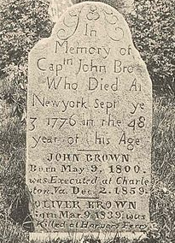
EXERCISE
Using the photograph of the gravestone to the right, what might we know about this person?
When were they alive?
What was life like then?
Were any significant events occurring during their life or when they died?

Slide 26
Closing
What skills and tools are needed to study History?
Use the Discussion Board to share your thoughts.

